Slide 1
DATS 6450 Cloud Computing Final Project Group 2
Hotel Booking Demand
Team Member:
Chen Chen, Hao Ning, Hungchun Lin

Slide 2
Project Overview
Introduction
Data Source
Expected Outcomes
Features Implemented
Project Architecture
Data Flow
1
2
3
4
5
6

Slide 3

Introduction
The hotel and hospitality sector caters to millions of travellers every day.
Hotel companies always want to optimize their revenue by accurately predict demand and price.
Customers always want to optimize their spending.
This hotel booking dataset can help us explore some interesting outcomes!
Notes:
The hotel and hospitality sector caters to millions of travellers everyday.
Hotel companies always want to optimize their revenue by accurately predict demand and price.
I think everyone here must have experience of booking hotels .
As a customers , you must want to optimize your spending. For the same room, you must prefer to pay less.
This hotel booking dataset can help us explore some interesting outcomes both useful for hotel holders and customers.

Slide 4
Data source
https://www.kaggle.com/jessemostipak/hotel-booking-demand
Resort Hotel and City Hotel data in 2015-2017
32 variables
119391 observations
Notes:
This data set contains booking information for a city hotel and a resort hotel from the same company in 2015 to 2017.

Slide 5
Data Description
Colnames | Data type | Colnames | Data type | Colnames | Data type
hotel | categorical | babies | integer | deposit_type | categorical
is_canceled | integer | meal | categorical | agent | categorical
lead_time | integer | country | categorical | company | categorical
arrival_date_year | integer | market_segment | categorical | days_in_waiting_list | integer
arrival_date_month | categorical | distribution_channel | categorical | customer_type | categorical
arrival_date_week_number | integer | is_repeated_guest | integer | adr(Average Daily Rate) | number
arrival_date_day_of_month | integer | previous_cancellations | integer | required_car_parking_spaces | integer
stays_in_weekend_nights | integer | previous_bookings_not_canceled | integer | total_of_special_requests | integer
stays_in_week_nights | integer | reserved_room_type | categorical | reservation_status | categorical
adults | integer | assigned_room_type | categorical | reservation_status_date | categorical
children | integer | booking_changes | integer
Notes:
information such as when the booking was made, length of stay, the number of adults, children, and/or babies, and the number of available parking spaces, among other things.

Slide 6
Outcomes
Occupancy of different Hotel type
Popular months/days for Resort Hotel booking and City Hotel Booking.
Most expensive months in a year or expensive days in a week.
Relationship between occupancy and price.
Cancelation rate.
Customer loyalty.
Presented in Website
>>>
http://hotelbookinganalysis.s3-website-us-east-1.amazonaws.com/

Slide 7
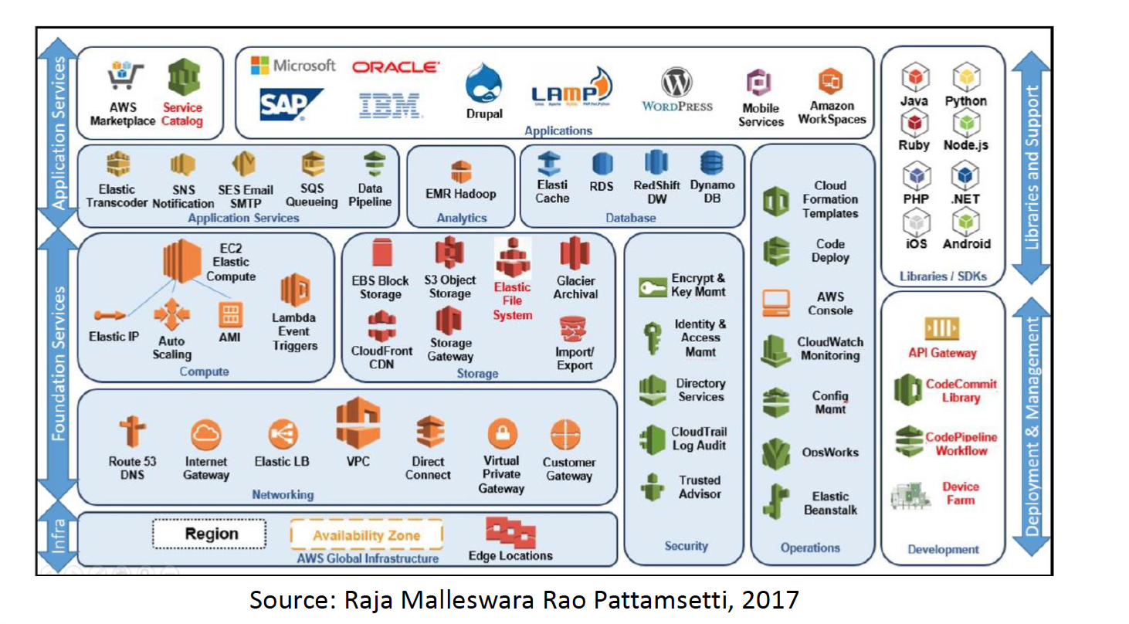

Features Implemented
+
SageMaker

Slide 8
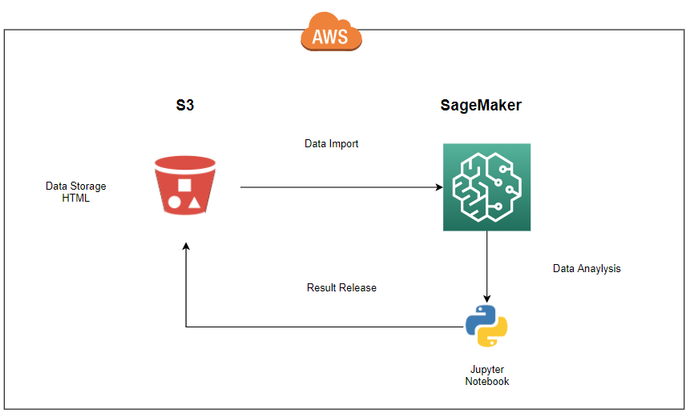
AWS Structure
Notes:
VPC with 2 public + 2 private subnets ( 2 regions)
Access database at private subnet through NAT gateway
Use python do pre-processing and data analysis
Results release to S3 webpage

Slide 9
Thank you!

